Slide 1
The concept as reflex of objective reality in thought
Marcelo J. S. Silva

Slide 2
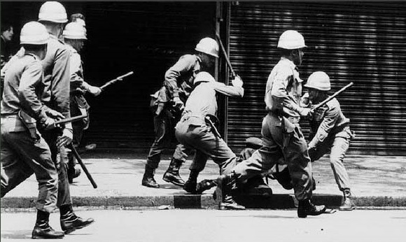
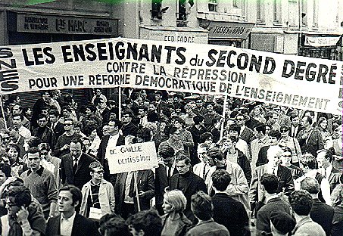
Collective Health (≠ Public Health)
The 1970s in Brazil
  Military dictatorship (1964-1985)
  Defeat of the cultural revolution of 1968
  Crisis of education of Public Health and Medicine

Slide 3
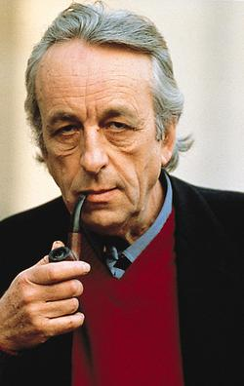
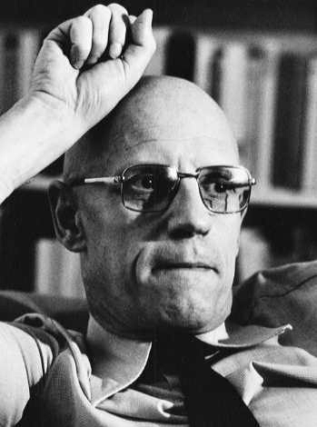
Collective Health
Reapper studies about Marx and Marxism
  Mainly based on Althusser (structuralism)
Distrust in Science (as a capitalist/modern rationality)
  Michel Foucault (proto postmodern)
Note: in Brazilian Social Sciences there is a fascination with French authors and a kind of displeasure with German ones

Slide 4
Collective Health
Struggle for democracy
Struggle for basic reforms (agrarian, urban, health system, etc.)
  Brazilian Health Reform (BHR)
Critic of an strictly biological understanding of health in Medicine and Public Health
  An epistemological critique
  Search for a new paradigma (scientific paradigm exhausted)

Slide 5
Collective Health
This critical movement of Health, against an strictly biological understanding of health, that helps originate BHR, influenced by Althusser and mainly Foucault, is what is called Collective Health.
Nowadays is a movement mainly postmodern and eclectic, but it is the critical movement of Health in Brazil.
  New authors are influenced by Foucault but they don’t know.
  Mix of positivism and postmodernism but they don’t know.

Slide 6
Collective Health
New society -> a postindustrial society
Need of a new rationality <- Foucault (epistemological critique)
The concept of health

Slide 7


Concept of Health
“The word, although an elaborated form of expression and communication, is insufficient to grasp reality in its entirety” Czeresnia (1999 p. 702). [there is not a concept of health]
A polysemy of definitions of health.

Slide 8
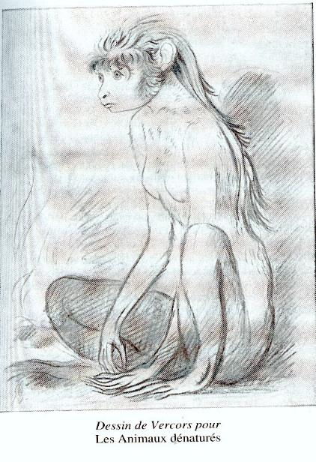
What is a concept?
A concept cannot be understood as concrete-factual features common to all subjects or objects of a particular group or set.

Slide 9
Work as essence of human being
The German Ideology (Marx and Engels)
Our conscience of life comes from life itself -> from production of life comes representation of life

Slide 10
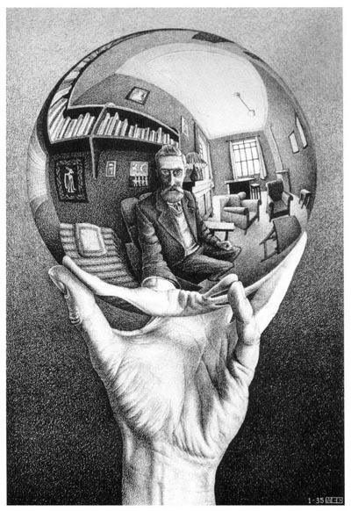

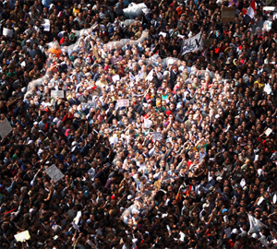
Concept as reflex of objective world
Chaotic concrete
Abstraction /
generalization
(concept)
Concrete in thought

Slide 11
Concept as reflex of objective world
Concepts are dependent and independent of an individual
  An individual think about the concept of an object
  But an object that is social
As the concept is about this social objective reality, concepts are social, thought of by individuals (that are social)

