Slide 1
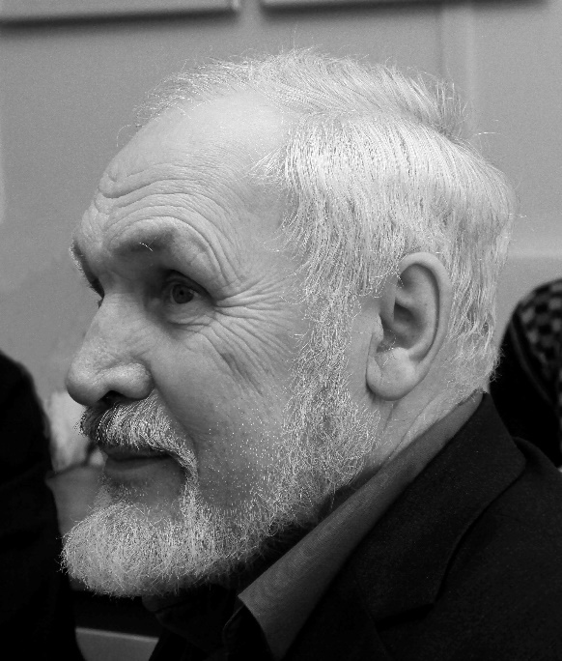
S.N. Mareev on paradoxes of Soviet philosophy
Sergei Mareev (02.05.1941-12.09.2019)

Slide 2
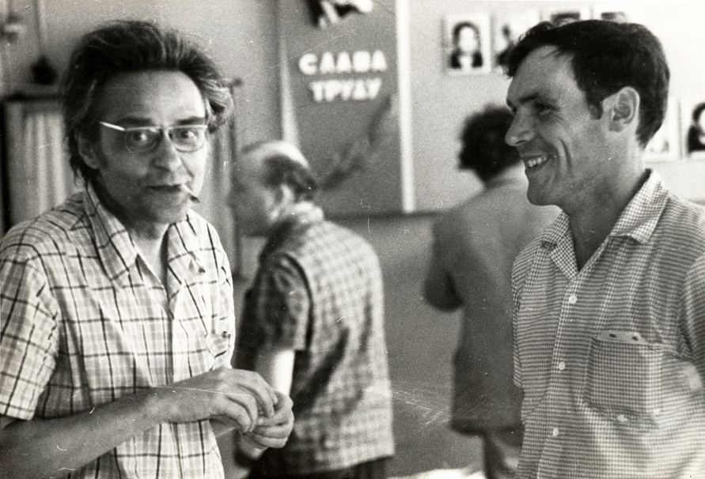
S. Mareev worked with Ilyenkov in the Theory of knowledge Sector in the Institute of Philosophy of the USSR from 1972 to 1979.

Slide 3
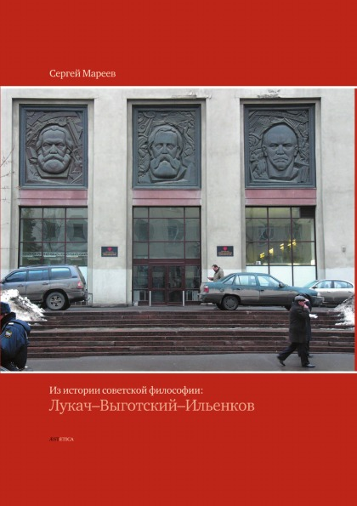
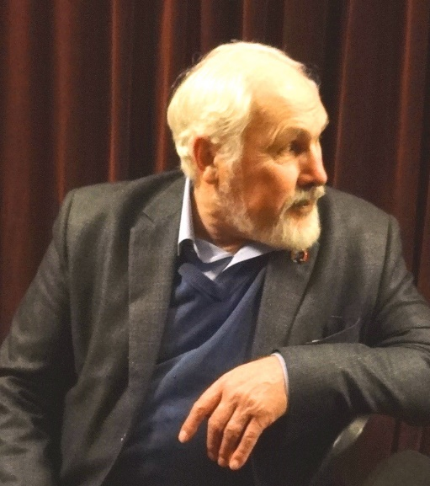
Mareev’s monograph «From the history of Soviet Philosophy: Lukács – Vygotsky – Ilyenkov» (2008) is an analysis of the history of Soviet philosophy from the standpoint of E.V. Ilyenkov and the "Ilyenkov school"
This interpretation of the Soviet philosophy history differed from:
the official Soviet version until the early 90s.
the official ANTI-Soviet version from the beginning of the 90s.
To the apologetics of Soviet Marxism and its radical rejection, Mareev opposed with genetic analysis of the socio-political and intellectual circumstances of the emergence this historical form of philosophical knowledge

Slide 4
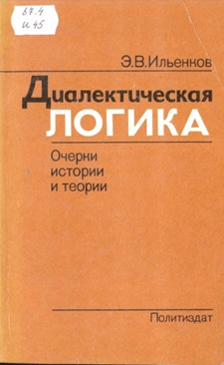
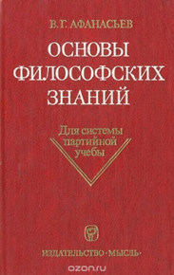

Mareev agreed with Ilyenkov that the official version of Soviet philosophy was metaphysical, and not by accident.
Evald Ilyenkov in his book "Dialectical Logic" called the official version of dialectical materialism "dialectics of boiling teapot" and opposed it to dialectics as dialectical logic.
Mareev in his book «From the history of Soviet Philosophy: Lukács – Vygotsky – Ilyenkov» (chapters 1 and 3) explanes:
- how "diamat" and "istmat" were formed as two sections of Marxist philosophy
- what role did the discussions between philosophers and natural scientists play here?
- what happened to the teaching of social disciplines
in the USSR

Slide 5
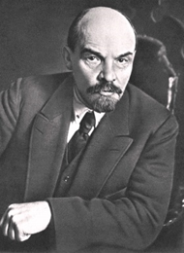
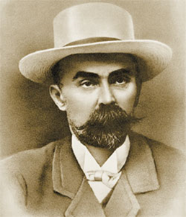
Mareev argued:
If the Diamat has become a new version of the ontology, then the Histmat has become a new version of the philosophy of history.
The negative role in the decomposition of historical and dialectical materialism into two parts and its transformation from methodology into philosophical ontology is associated with the role of G.V. Plekhanov in Russian Marxism.
It was from Plekhanov that the concept of «two materialisms» passed into Lenin's early works, «two materialisms» that make up the philosophy of Marxism– dialectical materialism and historical materialism.
Dialectics as
the “algebra of revolution” in Marxism
had to make a way for the dialectics of nature

Slide 6
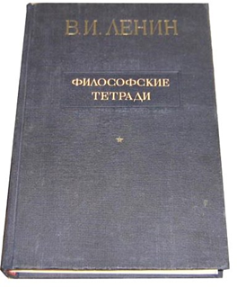
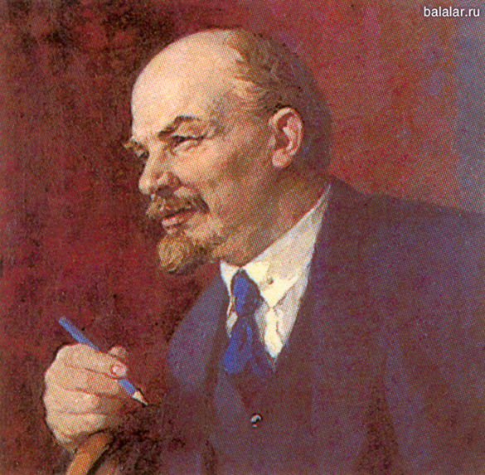
E. Ilyenkov appreciated and often quoted Lenin’s «Philosophical Notebooks» . (V. Lenin: «Philosophical Notebooks» 1914-1916 (10 notebooks of summaries and extracts, fully published in 1929)
Mareev describes the evolution of V.I. Lenin’s views from «Materialism and Empiriocriticism» to «The Philosophical Notebooks».
He clearly articulated the idea that the manuscript by Lenin „The Philosophical Notebooks” - the return to the roots of Marxism, to conception of Marxism as materialistic conception of history and the «algebra of revolution»

Slide 7
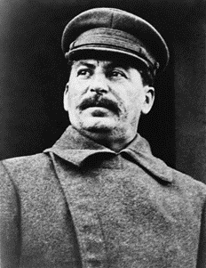
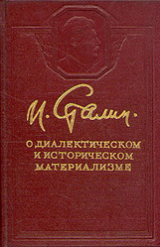
«Diamat» and «Istmat»
(dialectic materialism and historical materialism) as metaphysical version of the Marxist philosophy
  In 1938 the 4th chapter of Stalin’s The History of the Communist Party of the Soviet Union: Short Course (1938) constituted the official version of Marxist philosophy.
  It was a variant of «dialectical» metaphysics.
  The basis of dialectics is comprised of 5 forms of movement and 3 laws of ANY development.
  Historical materialism was interpreted as the application of the dialectic materialism to history.
  The basis of the historical materialism was the study of 5 Socio-Economic Formations.
As a result, the dialectics of the official soviet
philosophy turned from a revolution method into
a philosophical doctrine that matched the ideological conservatism of that period.

Slide 8
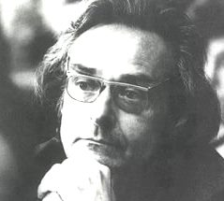
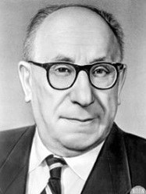

In 2016, materials from
Ilyenkov's archive were published
with his criticism of A. Deborin's views.
Although many believed that Ilyenkov was a follower of Deborin, Mareev was the first in his 2008 monograph to prove that the position of Ilyenkov is conceptually different from Plekhanov-Deborin line in the soviet philosophy.
Ilyenkov based on Lenin’s criticism
of this line in the
“Philosophical Notebooks”.

Slide 9
  Following Ilyenkov, Mareev argued that the transformation of Marxism into a metaphysical version of philosophy was a consequence of the fact that Soviet society could realize only a formal socialization, and not the real one. The Soviet government that has stopped the movement to the real collectivization made the «general property» a prey for the bureucracy. But the failure of Soviet society was a part of the global crisis of modern society, where the technological progress is combined with the aggravation of alienation in its various forms.
Mareev analyzed in detail the indicated socio-political reasons in the work “E.V. Ilyenkov and socialism "(Problems of Philosophy. 2004. No. 3. P. 101-110)
He had a stoic attitude toward what happened to the Marxist theory and practice in the USSR. Admitting its´ defeat openly, he considered it to be temporary.

Slide 10
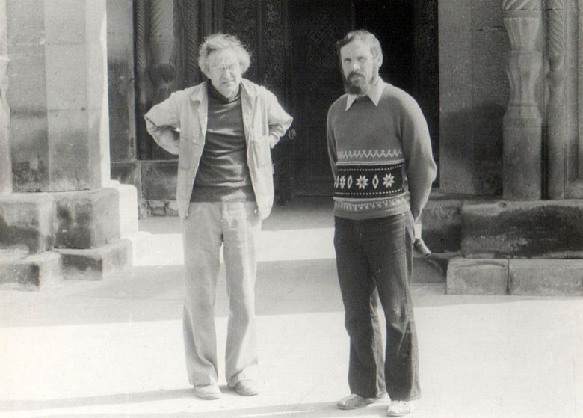
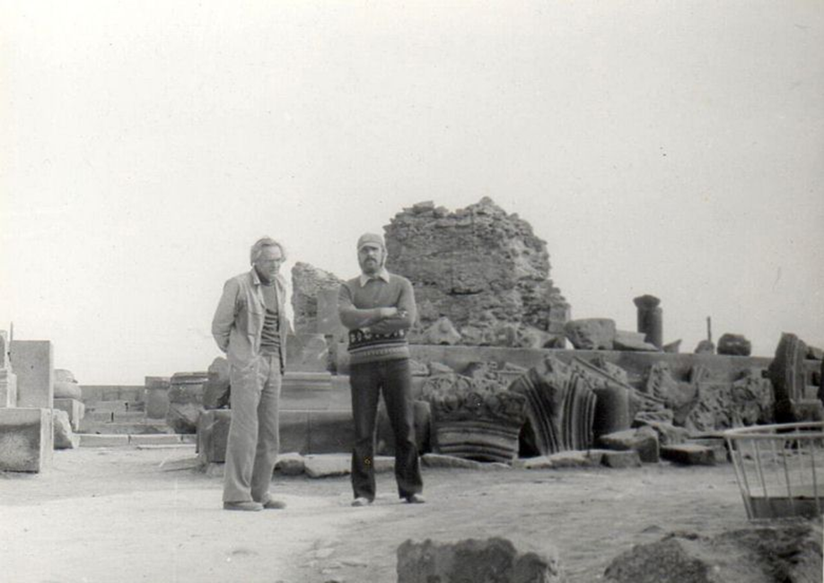
Trip to Yerevan 1978

Slide 11
Thank you for your attention!

